Slide 1
Artificial Meat Review Predictions
Tamar Brand-Perez, Tiffany Price, Ben Tubbs, and Jose Santos

Slide 2
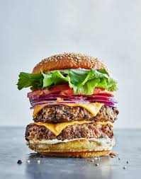
Team Members & Responsibilities
Tiffany Price:
Project Manager
Ben Tubbs:
Machine Learning Lead
Tamar Brand-Perez:
Database Lead
Jose Santos:
Github Lead
Notes:
Tiffany
All ended up helping each other throughout the process
Tiffany: Project Manager
Ben: Machine Learning Lead
Tamar: Database Lead
Jose: Github Lead

Slide 3
Executive Summary
Overview
The fake meat industry has recently experienced a dramatic positive shift in consumer interest and exponential growth. Our team wants to predict how consumer reviews affect ratings, which will assist store owners in their decision making process of which brand to sell.
Objectives
By analyzing the Amazon consumer reviews between 2017 - 2021, our machine learning tool will predict whether a non-rated review will be positive or negative.
Notes:
Tiffany
Overview
The fake meat industry has recently experienced a dramatic positive shift in consumer interest and exponential growth. Our team wants to predict how consumer reviews affect ratings, which will assist store owners in their decision making process of which brand to sell.
Objectives
By analyzing the Amazon consumer reviews between 2017 - 2021, our machine learning tool will predict whether a non-rated review will be positive or negative.

Slide 4







Products Used
Technology
Tools
Language
Algorithms
Algorithm: Bag of Words Model
Machine Learning: Naive Bayes Classifier
Notes:
Tiffany
Technology used: Tableau & SQ Lite
Tools used: Git Hub, Plotly, Flask, TablePlus
Language used: Python
Algorithms used: Bag of words model, Machine Learning: Naive Bayes Classifier

Slide 5
Data Exploration & Analysis

Slide 6
Database

Slide 7
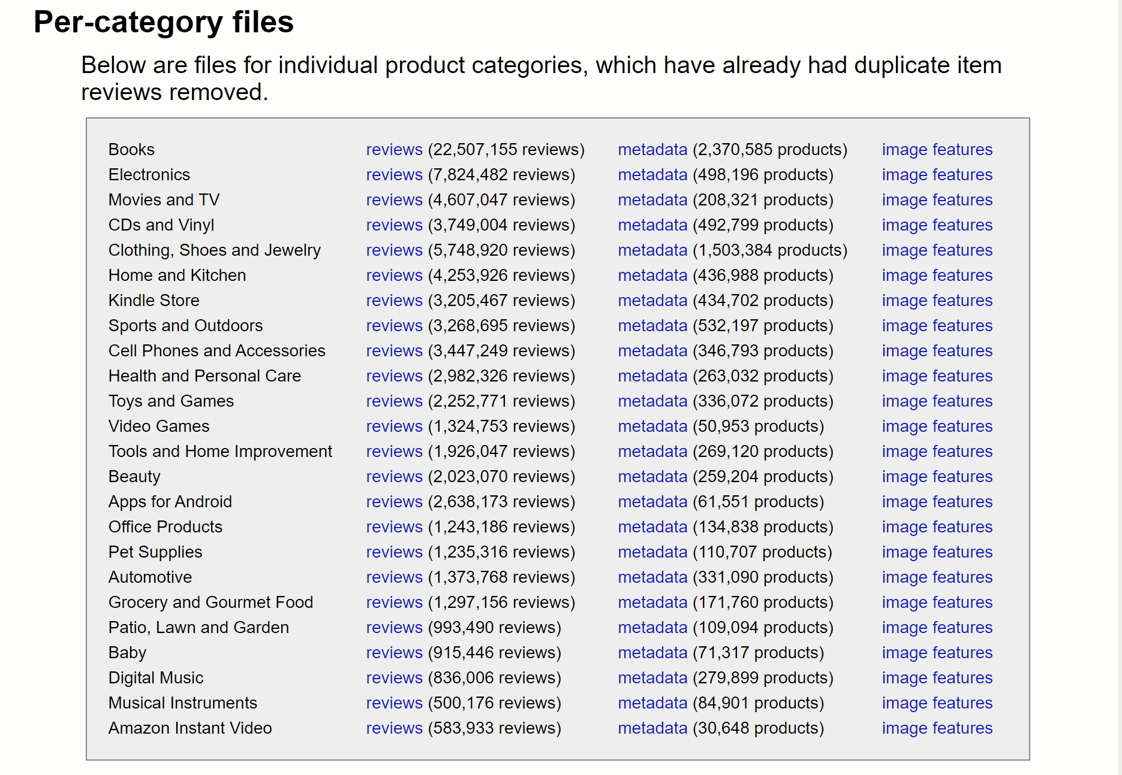
Exploration
Amazon product data
Reviews
*****/*
text
review length
Metadata
brand
product
price
Notes:
Our initial goal was to use amazon reviews to create a machine learning algorythm that accurately predicts whether a review is positive or negative.
In the reviews dataset the information provided was the rating 1 through 5 stars, the review text as well as other information such as date etc. We decided we wanted to know if there was a connection between the length of the review and the rating so I created another column that counted the number of words in each review with a lamda function. That was the review length column.
Our goal was to focus on fakemeat products but in the reviews dataset there was no brand and product information so we added the metadata dataset hoping that it would be easy to combine the two and find reviews specifically about fake meat.
That did not work well since from a dataset of more than 5 million reviews, the number of reviews about fakemeat was small. Then when we combined the metadata about fakemeat with the original reviews dataset, we were left with no data. We found out that it was due to the asin numbers not matching. After multiple attempts at merging joining, and concatinating the data with no significant success we decided to shift to scraping reviews with product and brand information.

Slide 8
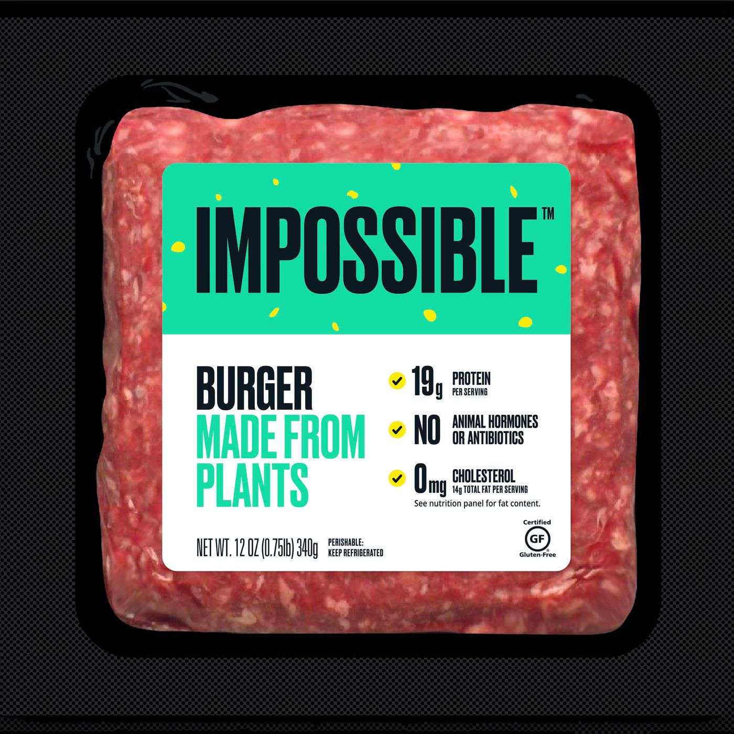
Exploration (cont’d)
Amazon product data (cont’d)
scraping
*****/*
text
brand
product
price
Notes:
We scraped data from amazon to add the brand product price information
We focused specifically on fake meat products.
We wanted to learn about impossible meat products but it was impossible because we focused on amazon and amazon do not have their products.
So we chose 5 other common fakemeat products.
Once our machine learning algorythm is trained with this data, we could take reddit reviews that do not have a star rating and use our algorithm to determine if the review is positive or negative. This way we do not rely on the amazon rating and can provide groceries store owners with more information about fakemeat products.

Slide 9
Questions
Inform store owners:
positive or negative review?
Frequent words reviewers associate with a brand.
price change over time?
rating change over time?
Notes:
Questions the team hopes to answer with this data:
Inform store owners about fake-meat products so they can make decisions whether they want to have these products in their store.
Did a fakemeat product receive a positive or negative review?
What are some keywords that users use frequently when giving positive or negative reviews.
Did the price of these fakemeat product change over time?
Did the rating of these products change over time?

Slide 10
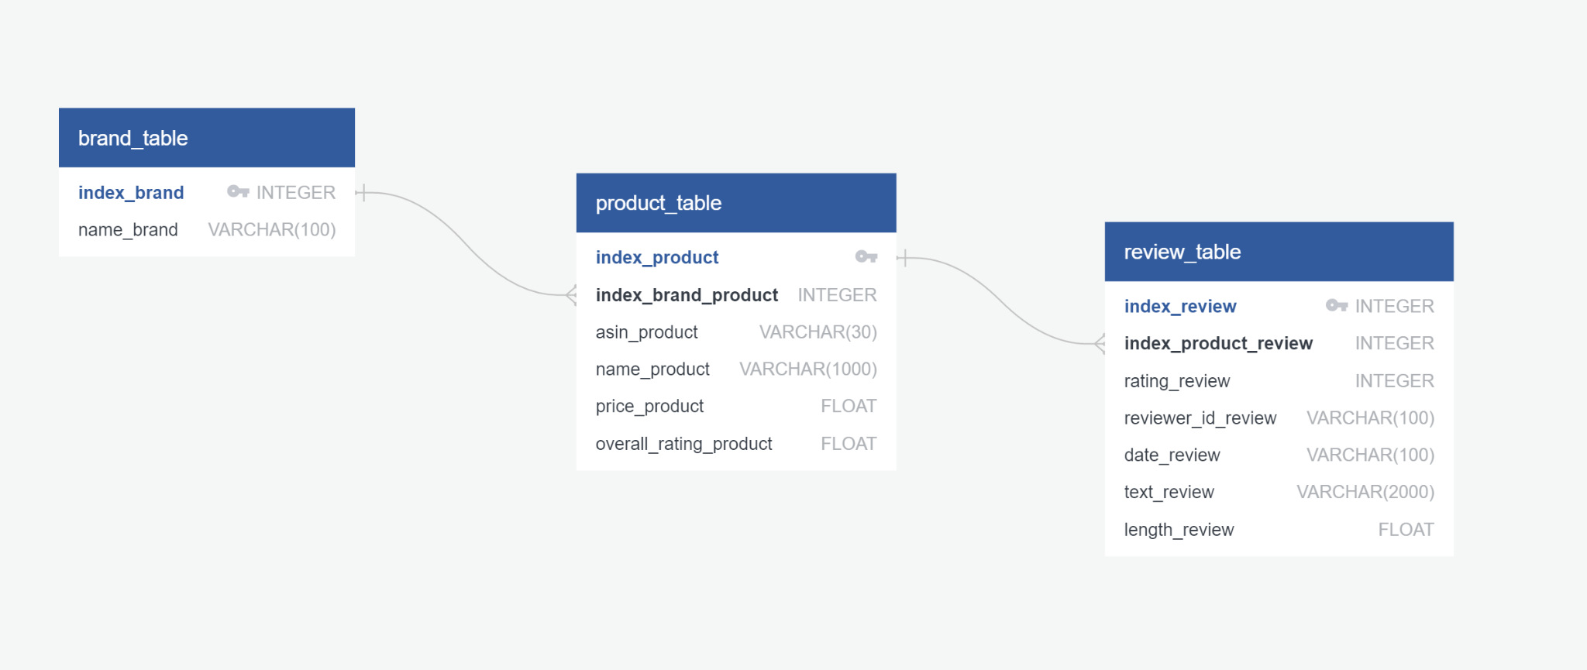
Database
Notes:
Database
Sqlite and sqlalchemy were used to create a database.
The database is accessed with python and also using table plus.
This ERD is showing the three tables in the database. The first one is of the brands. The second is the products. Since each brand has several products, the connection is one to many

Slide 11
Machine Learning
Notes:
We are creating a sentiment analyzer that classifies reviews as positive or negative.
Our dataset is a collection of Amazon reviews that we used to train the model. Amazon reviews may contain any type of lexicon including words that are misspelled, abbreviated, capitalized, contain punctuation, etc. The first step is to normalize this lexicon so that items such as “I’m”, “Im”, “i’m” and “im” are not treated as different words.

Slide 12
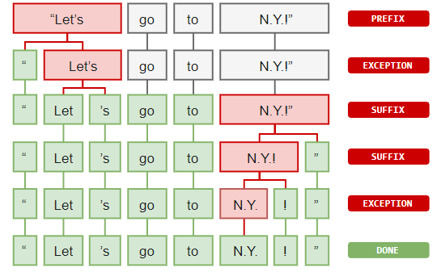
Preprocessing and Normalization
Tokenization
Casing
Removing Non Alphanumerics
Length
Stop Words
Lemmatization
Notes:
We need to split the sentence into a list of words for processing. We could do something simple like split the sentence at each word space. Tokenizers split words in an intelligent way, so that words with periods, such as “Mr.” are not treated as separate tokens.
Normalization
Casing - The first step was to switch every letter of every token to lowercase, so that tokens such as “The” and “the” would not be treated as separate entries
Removing Non Alphanumerics - Next all letters that were not alphanumeric were removed to prevent words such as “mr” and “mr.” from being treated as separate tokens
Length - All tokens that were less than length 2 were also removed
Stop Words - Stop words were removed
Lemmatization - All words were lemmatized for greater normalization

Slide 13
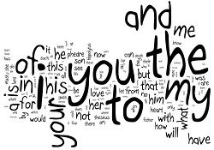
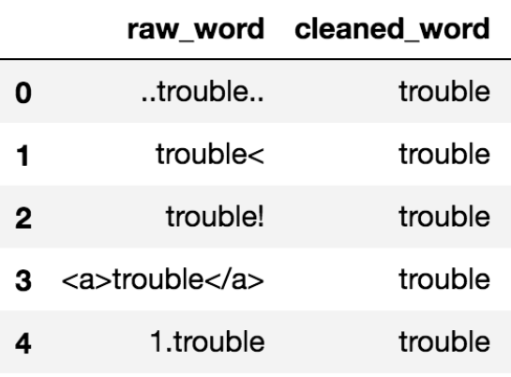
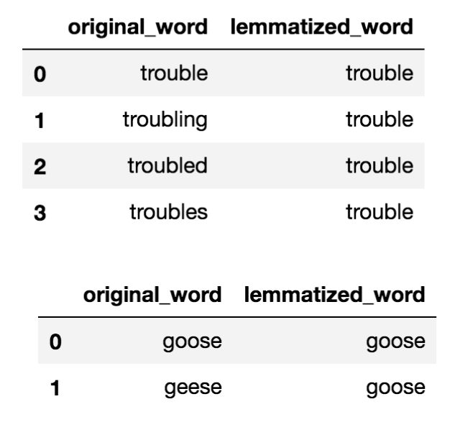
Cleaning
Notes:
Stop words are words that do not add a lot of meaning to the text such as “the”, “it”, “as” and “about”. Stop words were removed.
The same word may come in many forms, such as: “eat”, “ate”, “eaten”, etc. All of these words can be normalized to what are called lemmas so that they are not treated as separate tokens, but as the same token.

Slide 14
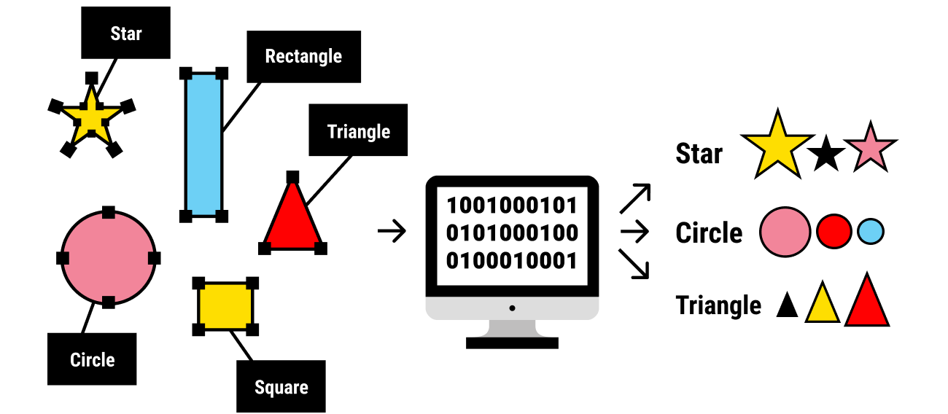
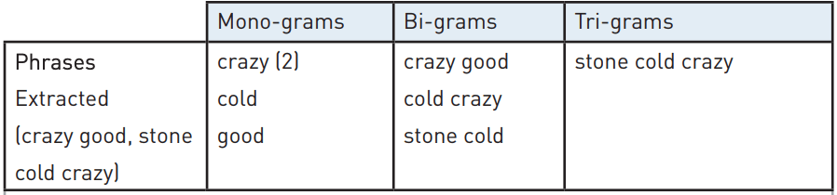
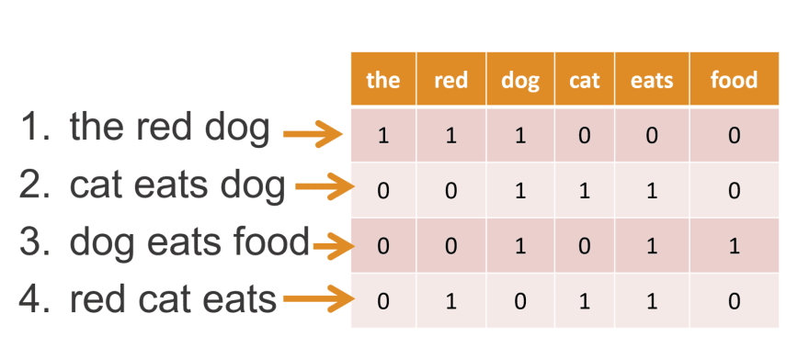
Featureset
Notes:
Next, we need to create the labeled data. We used only the five star reviews as positive and the one star as negative. There were many more positive than negative reviews, so we used only 1000 of each to eliminate bias in the model. We used monograms which means each word is treated separately and word order is not taken into account. We then turned each review into a vector (a python dictionary) of the 3000 most common words in all of the reviews. This dictionary stores the presence or absence of each of the 3000 most common words in all of the reviews.

Slide 15
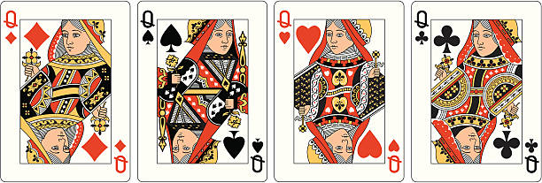
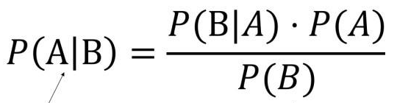
Naive Bayes
P(Queen | Face) =
P(Face | Queen) * P(Queen) / P(Face)
P(Face | Queen) is 1
P(Queen) is 4/52 = 1/13
P(Face) is 12/52 = 3/13
P(Queen | Face) = 1 * (1/13) / (3/13)
= (1/13) * (13/3)
= 1/3
(Correct since 4 Queens out of 12 Face cards = 4/12 or 1/3)
Notes:
We used a Naive Bayes classifier on the model which makes uses that the probability of A occurring given B is equal to the probability of B occurring given A multiplied by the probability of A over the probability of B. A simple example would be to imagine you are drawing a card from a deck of cards. Imagine you know you drew a face card, what is the probability that you drew a queen? This is equal to the probability of face card given you drew a queen (1) times the probability of a queen (1/13) over the probability of a face card (3/13). This comes out to ⅓ which is the correct answer.

Slide 16
Naive Bayes and NLP
P(Positive | Fake meat is delicious) =
P(Fake meat is delicious | Positive) * P(Positive) / P(Fake meat is delicious)
P(Positive | fake) * P(Positive | meat) * P(Positive | delicious)
We do the same for the negative.
P(Positive | Fake meat is delicious) > P(Negative | Fake meat is delicious)?
Notes:
We train the model by changing each word slightly when it shows up in a positive or negative review. This is where the Naive part of the Naive Bayes classifier comes in. We are going to assume that the probability a sentence is positive is equal to the probability that each word the sentence is positive. When we check a review, we multiply the probability that each word of the review is positive or negative together and we do the same for the negative, and decide which of these values is greater in order to classify the review.

Slide 17
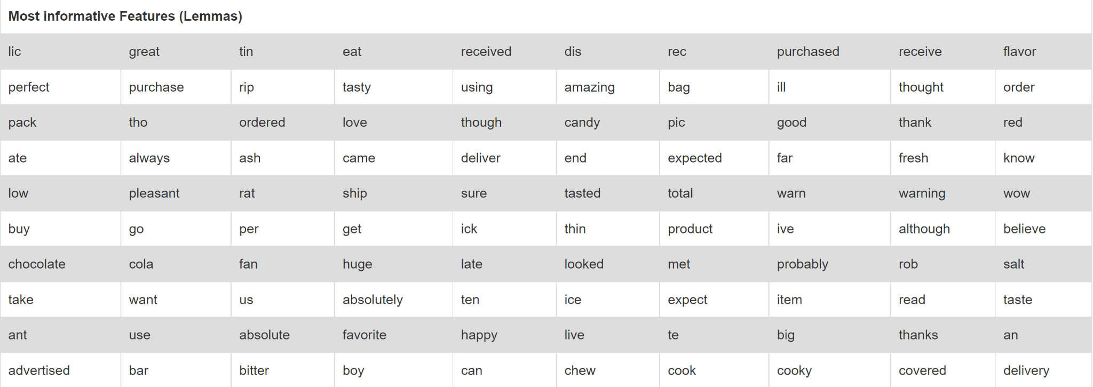
Most Informative Features
Notes:
Here are some interesting statistics from one version of our model. These are the most informative features going left to right and top to bottom.

Slide 18
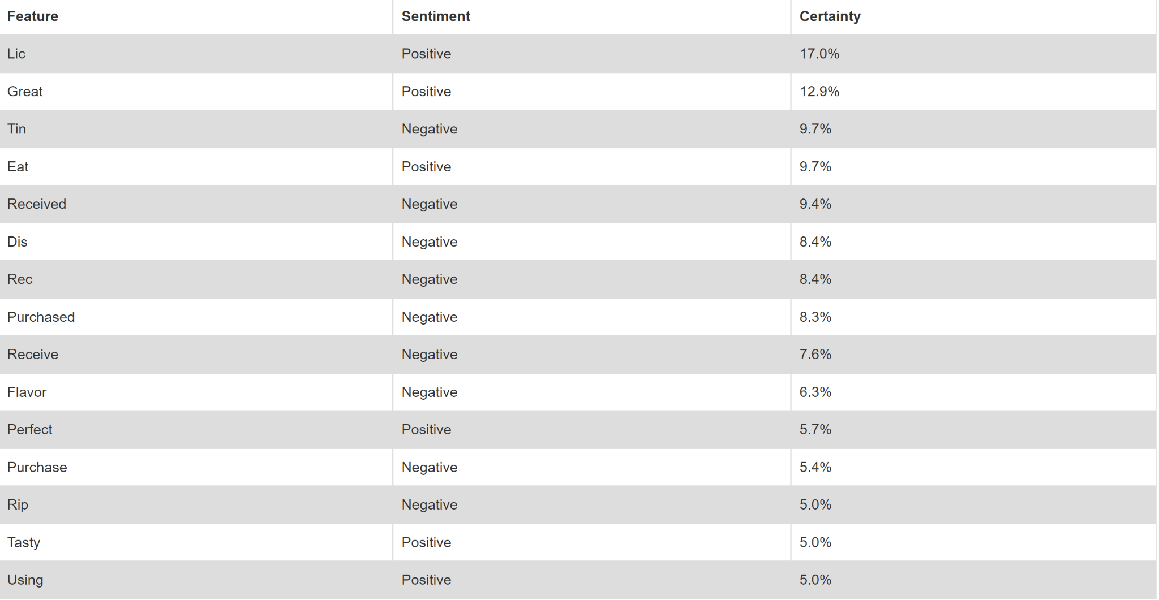
Most Informative Features II
Notes:
Here are the top fifteen most informative features along with whether they are positive or negative and the percentage of how telling they are.

Slide 19
Dashboard
Notes:
Tiffany - introduction
To create visualizations in Tableau, we scraped amazon for reviews and ratings of 5 fake meat brands. Using over 1,000 reviews we were able to analyze various aspects of the data. Jose will explain in detail.

Slide 20
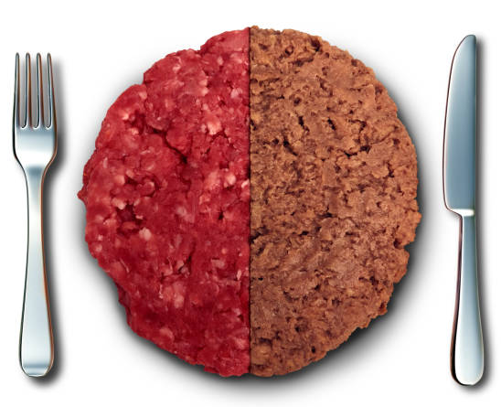
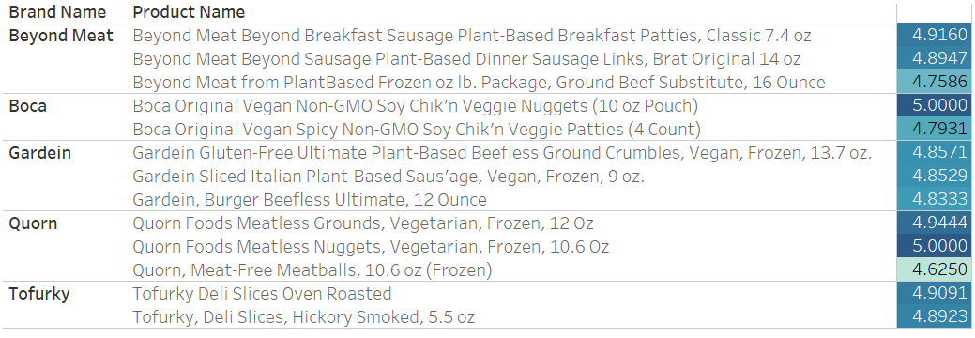





Fake Meat Products Reviewed
Notes:
An average of 3 products per brand were included in the analysis.
Rating on right is colored per brand.
RATINGS ARE INCORRECT - NEED TO RECALCULATE FROM FULL DATASET

Slide 21
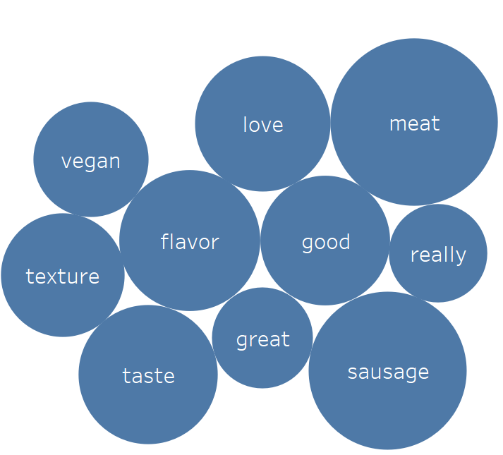
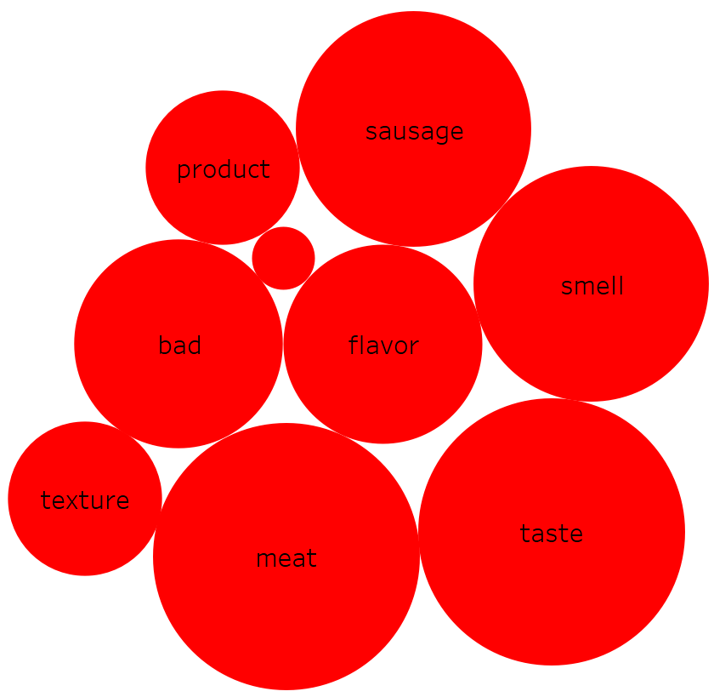
Fake Meat Brand Sentiment
Vegan, love, good, really, great
Product, bad, smell
Notes:
Two word clouds to show the 10 most frequent words used in positive (blue circles) and negative reviews (red circles). Stars indicate words that are only used in one sentiment review (positive or negative).
This view allows a store owner to associate keywords that define a brand with positive and negative reviews. By doing so, the store owner is afforded a comparison between positive and negative “traits” per brand (as shown here) or positive/negative traits for a brand comparison (see next slide)
Starred words indicate words with high frequency in a sentiment review and that do not show up in high frequency on the opposite sentiment review.
Process:
Created word cloud by taking text of reviews in csv format - 1000 total reviews (200 per brand, 40 by product per brand) - note that there were 870 positive reviews and only 130 negative reviews - and converting text to columns.
Then filtered out CSV file to only contain 1) reviews with ratings of 1 or 2 (negative reviews) and 2) reviews with ratings of 4 or 5 (positive reviews) to create two new CSV files.
Next each csv file was saved as unicode text and imported as a data source into tableau.
Stop words were filtered out using a list of words taken from: xxx
Then a filter was applied to only show the top 10 most frequent words for each brand.

Slide 22
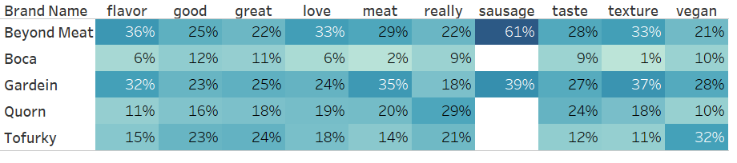
Keyword frequency by brand in positive reviews
Notes:
Info on how often a keyword (top 10 from all reviews) is used in a review of a product of a brand - brand to brand comparison. E.g. out of total number of times that “flavor” was used in positive reviews for all brands (100%), 36% of those instances were found in reviews of Beyond meat products.
This view allows the store owner to perceive how each reviewer associates a keyword in a POSITIVE review with a certain brand.
The bordered cells indicate the brand for which that particular word was used with the highest frequency.
Cells are colored from light blue (low frequency) to dark blue (high frequency) according to percent observed down a column.

Slide 23
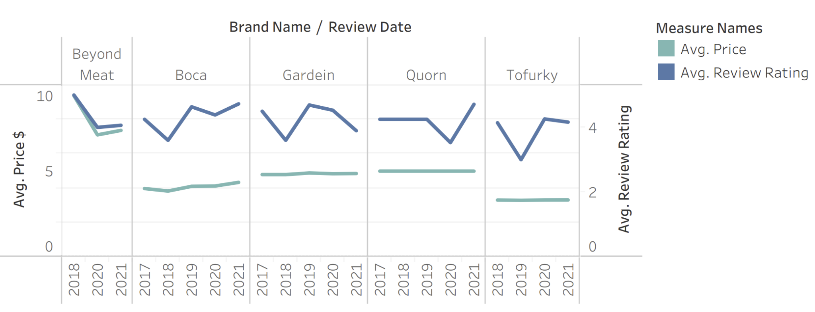
Review v. Price by Brand per Year
Notes:
Tiffany
This slide reflects both price and review by brand each year. We wanted to see if there was a correlation between fluctuation of price v consumer rating. As you can see, there was a strong correlation between the price drop and ratings of Beyond Meat. Boca’s also seem to be correlated. Interestingly, Gardein’s reviews are decreasing while the prices are slightly increasing.

Slide 24
Conclusion

Slide 25
Results
80.### % accuracy from ML model
Limitations
Notes:
Jose
80.### % accuracy from Machine Learning model
Confusion matrix
Limitations: working with local database

Slide 26
In Summary
Recommendation for Future Analysis
Interactive visualizations
Larger data set
What Our Team Would Have Done Differently
Improve the algorithm to make it more than 80% accurate
Algorithm does not consider the order
Notes:
Tamar
Recommendations for Future Analysis
What our Team Would Have Done Differently
Improve the algorithm to make it more than 80% accurate
Algorithm does not consider the order of the words

Slide 27
Demo
https://project-group-3.herokuapp.com/

Slide 28
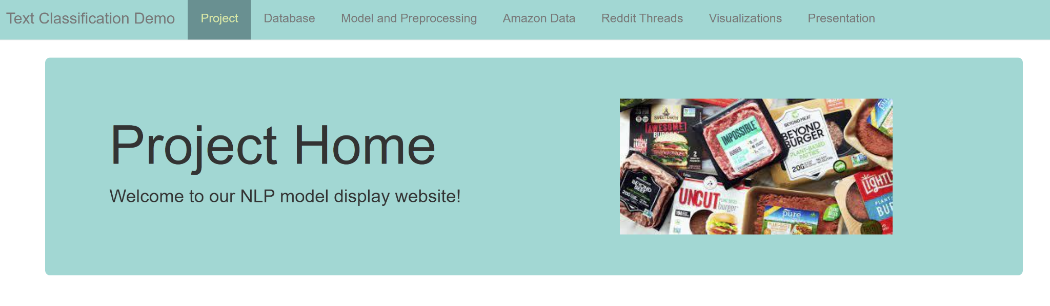
Interactive Dashboard
Notes:
Ben
Explanation of website/dashboard and interactivity features to predict if a review will be classified as a positive or negative review.

Slide 29
Things to include from the module
Content: The presentation should tell a cohesive story about the project and include the following:
Selected topic
Reason the topic was selected
Description of the source of data
Questions the team hopes to answer with the data
Description of the data exploration phase of the project
Description of the analysis phase of the project
Technologies, languages, tools, and algorithms used throughout the project
Result of analysis
Recommendation for future analysis
Anything the team would have done differently

Slide 30
Live Presentation
Requirements for the live presentation follow:
All team members present in equal proportions.
The team demonstrates the dashboard's real-time interactivity.
The presentation falls within any time limits provided by the instructor.
The submission includes speaker notes, flashcards, or a video of the presentation rehearsal.

Slide 31
Purpose & Sourcing
Amazon Grocery and Gourmet Food data set: (http://deepyeti.ucsd.edu/jianmo/amazon/index.html).
NLP was used to train a sentiment classifier.
Goals:
Predict user sentiment for artificial meat products.
Assist store owners’ with their analysis.
Notes:
Tiffany
Our data set was pulled from Amazon Grocery and Gourmet Food data set: (http://deepyeti.ucsd.edu/jianmo/amazon/index.html).
Natural Language Processing machine learning model was used to train a sentiment classifier on the dataset containing over 1 million reviews.
The goal of this classifier is to predict user sentiment (positive or negative) for artificial meat products.
We believe this analysis and our interactive dashboard will assist store owners’ decisions regarding which artificial meat products to sell in their stores.

Slide 32
Sentiment specific keywords
 | KEYWORDS | KEYWORDS
 | Vegan, love, good, really, great | Product, bad, smell
 | Vegan, love, good, really, great, meat | Bad
 | Vegan, love, good, really, great, texture, sausage, flavor | Bad
 | Vegan, love, good, really, great | Bad, product, food
 | Vegan, love, good, really, great, taste, meat | Bad, smell, food
Notes:
Sentiment specific keywords taken from word cloud - words that show up with high frequency in a sentiment review but do not show up on the opposite sentiment review.

Slide 33
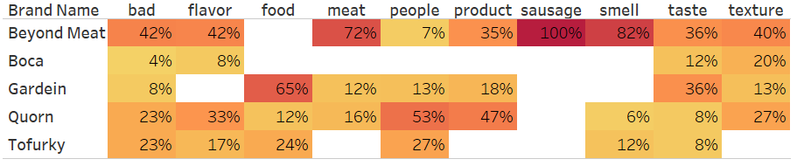
Keyword frequency by brand in negative reviews
Notes:
Info on how often a keyword (top 10 from all reviews) is used in a review of a product of a brand - brand to brand comparison. E.g. out of total number of times that “flavor” was used in positive reviews for all brands (100%), 36% of those instances were found in reviews of Beyond meat products.
This view allows the store owner to perceive how each reviewer associates a keyword in a NEGATIVE review with a certain brand.
The bordered cells indicate the brand for which that particular word was used with the highest frequency.
Cells are colored from light yellow (low frequency) to dark red (high frequency) according to percent observed down a column.

Slide 34
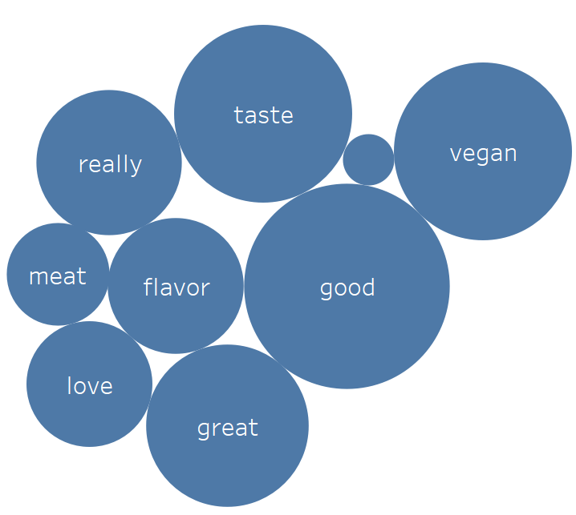
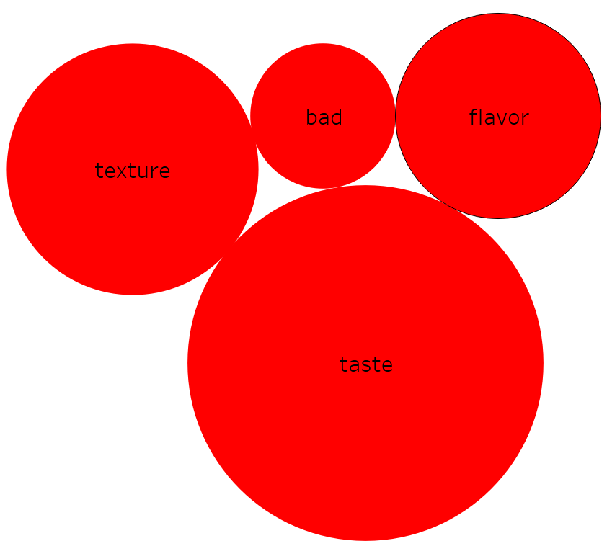
Fake Meat Brand Sentiment
Vegan, love, good, really, great, meat
bad
Notes:
Brand choices:

Slide 35
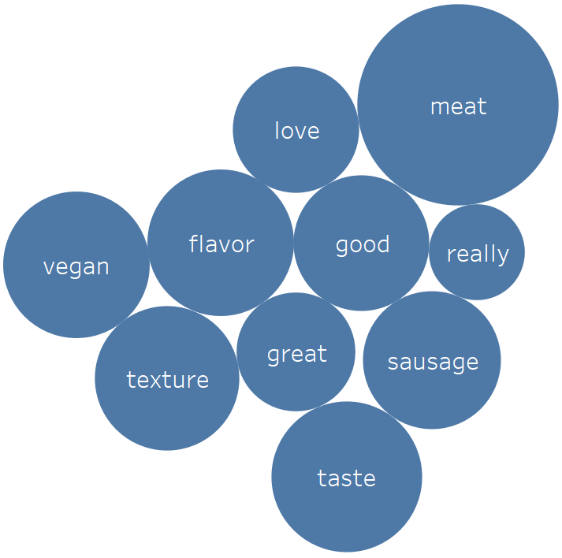
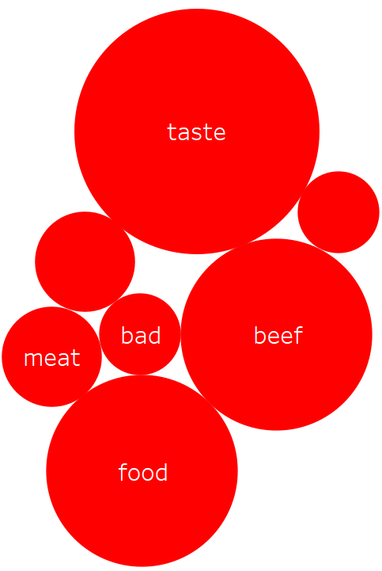
Fake Meat Brand Sentiment
Vegan, love, good, really, great, texture, sausage, flavor
bad
Notes:
Brand choices:

Slide 36
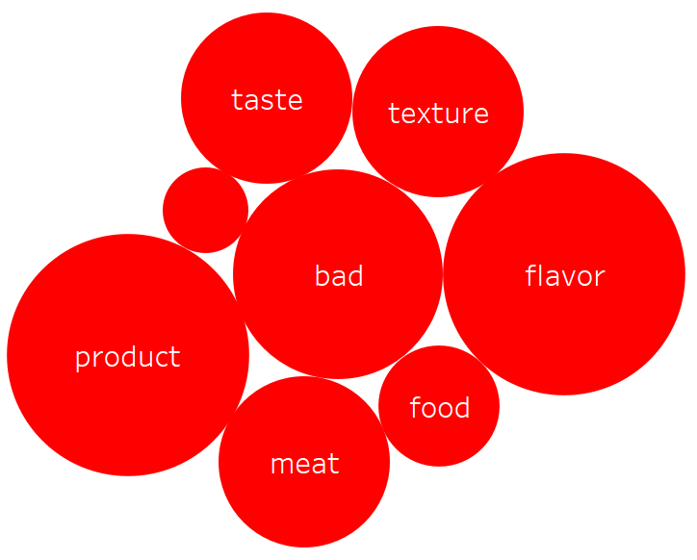
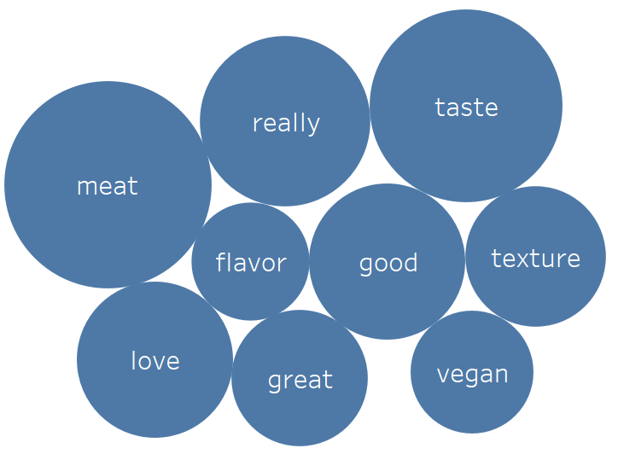
Fake Meat Brand Sentiment
Vegan, love, good, really, great
Bad, product, food
Notes:
Brand choices:

Slide 37
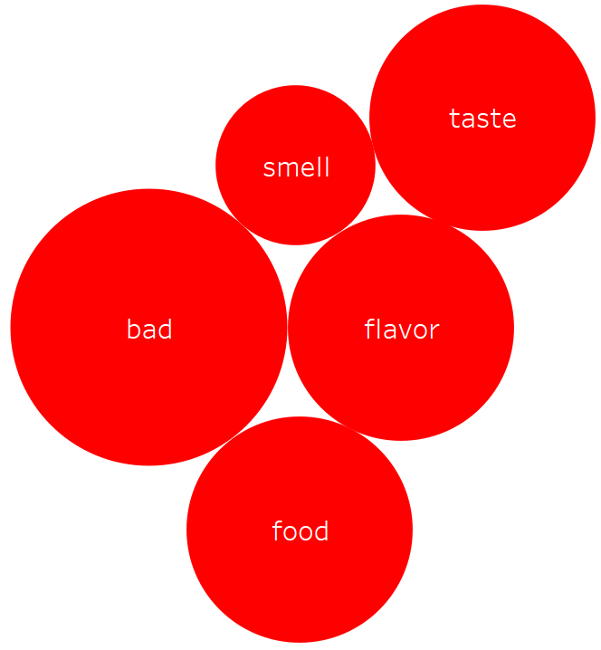
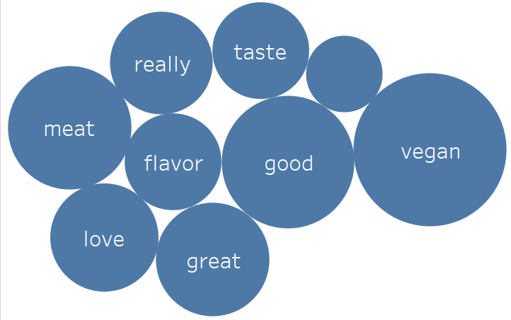
Fake Meat Brand Sentiment
Vegan, love, good, really, great, taste, meat
Bad, smell, food
Notes:
Brand choices:

Slide 38
Fake Meat Brand Sentiment
bad
Product, bad, smell
Notes:
Two word clouds to show the 10 most frequent words used in positive (blue circles) and negative reviews (red circles). Stars indicate words that are only used in one sentiment review (positive or negative).
This view allows a store owner to associate keywords that define a brand with positive and negative reviews. By doing so, the store owner is afforded a comparison between positive and negative “traits” per brand (previous slide) or positive/negative traits for a brand comparison (this slide)
Starred words indicate words with high frequency in one brand and that do not show up in high frequency in a review of a product from a different brand.

